Slide 1
APOLOGETICS
IN ONE LESSON
almost
Ai1L.net
Lesson 17
The Gospel According to God (Isaiah 53)

Slide 2
Key Takeaways (in review)
1
There are several passages that explicitly say that Jesus is God (including in Mark)
2
There are many passages which make an argument for Jesus’ divinity based on Old Testament references
3
Many statements from Jesus would be incredibly weird if Jesus isn’t God

Slide 3
IDEA IN BRIEF
What?
know that Isaiah 53 predicts the Gospel story in great detail 700 years prior to its arrival
Why?
So that can use this example of fulfilled prophecy to support the claim that the Gospel comes from God
How?
By examining how well Isaiah 53 describes the Gospel story

Slide 4
Isaiah Quotations

Slide 5
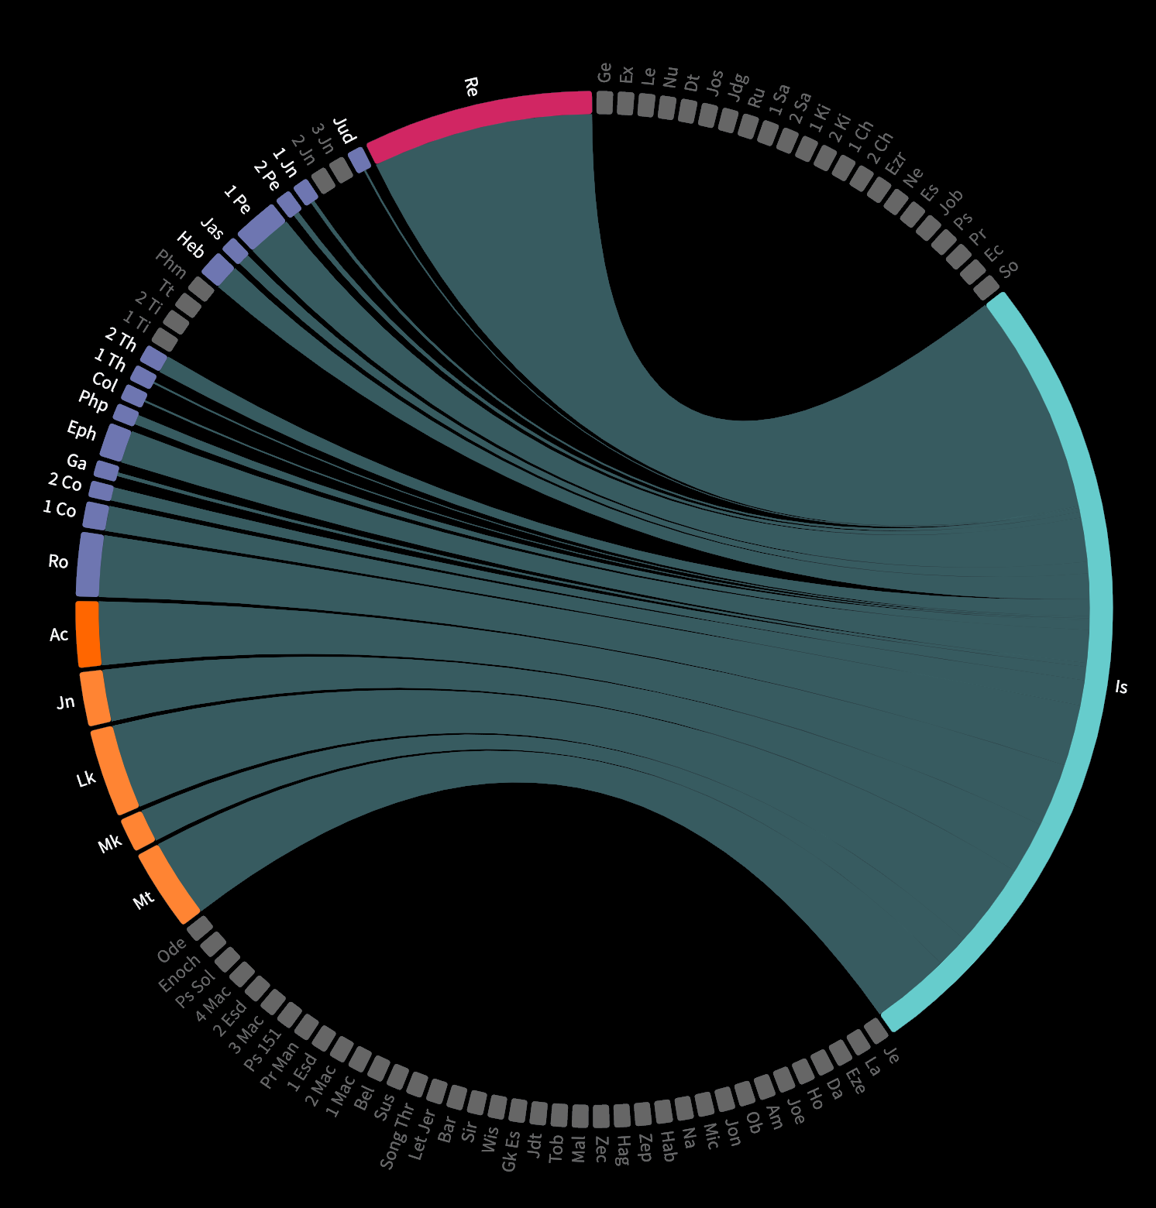

Slide 6
Isaiah Outline
1-39
judgment leading to captivity
40-66
God’s saving work for deliverance
40-48
deliverance from Babylonian captivity
49-57
deliverance from sin
53:5
center of this section: the cross
55
call to faith for the promise of salvation
56
mercy extends to Gentiles
57
condemnation of harsh leaders
58-66
full deliverance from the fall

Slide 7
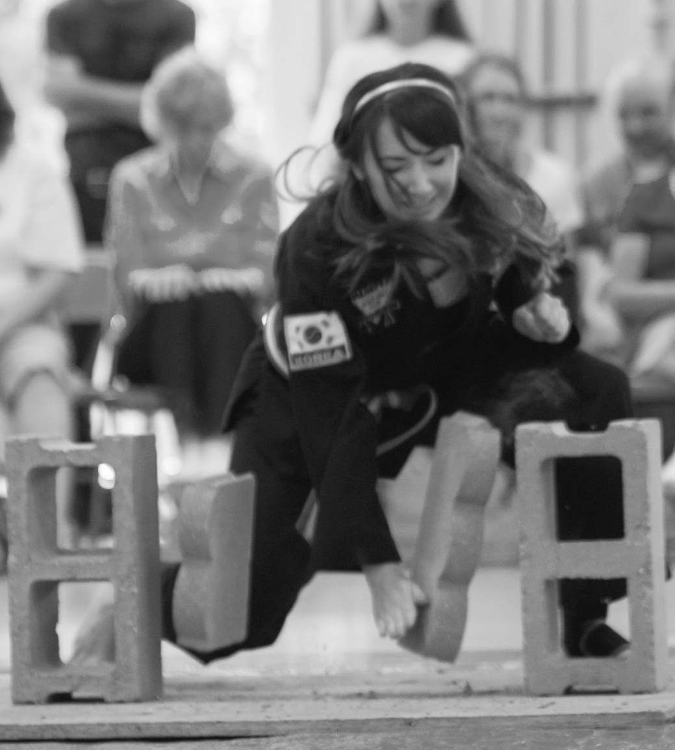

Slide 9
Past Tense
Appalled at him
Disfigured
Message was not believed
Grew up like a tender shoot
Despised and rejected
Took on others’ infirmities
Pierced for our transgressions
Sheep have gone astray
Lord laid iniquity on him
Didn’t open his mouth
Led to the slaughter
Cut out from the land of the living
Soul made a guilt offering
Done no violence
Bore the sins of many
Made intercession for the transgressor
Future Tense
Prosper
Exalted
Sprinkle many nations
Kings will shut their mouths
Those who did not see will understand
See his offspring
Prolong his days
See the light of life
Allotted a portion with the great
Justify many, bear their iniquities
Divide the spoils with the strong

Slide 10
52:13-15 | Astonishment
53:1-3 | Rejection
53:4-6 | Substitution
53:7-9 | Silence
53:10-12 | Triumph

Slide 11
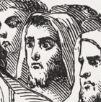
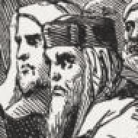
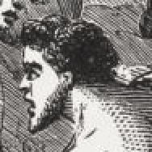
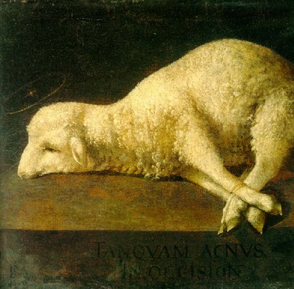
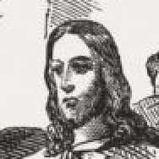
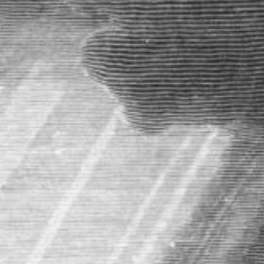
52:13-15 | Astonishment
53:1-3 | Rejection
53:4-6 | Substitution
53:7-9 | Silence
53:10-12 | Triumph

Slide 12
Astonishment (52:13-15)
1

Slide 13
“Behold, my servant shall act wisely; he shall be high and lifted up, and shall be exalted. ”
ISAIAH 52:13

Slide 14
“As many were astonished at you— his appearance was so marred, beyond human semblance, and his form beyond that of the children of mankind—”
ISAIAH 52:14

Slide 15
“so shall he sprinkle many nations. Kings shall shut their mouths because of him, for that which has not been told them they see, and that which they have not heard they understand. ”
ISAIAH 52:15

Slide 16
Rejection (53:1-3)
2

Slide 17
“Who has believed what he has heard from us? And to whom has the arm of the Lord been revealed?”
ISAIAH 53:1

Slide 18
“For he grew up before him like a young plant, and like a root out of dry ground; he had no form or majesty that we should look at him, and no beauty that we should desire him.”
ISAIAH 53:2

Slide 19
“He was despised and rejected by men, a man of sorrows and acquainted with grief; and as one from whom men hide their faces he was despised, and we esteemed him not. ”
ISAIAH 53:3

Slide 20
Substitution (53:4-6)
3

Slide 21
“Surely he has borne our griefs and carried our sorrows; yet we esteemed him stricken, smitten by God, and afflicted. ”
ISAIAH 53:4

Slide 22
“But he was pierced for our transgressions; he was crushed for our iniquities; upon him was the chastisement that brought us peace, and with his wounds we are healed. ”
ISAIAH 53:5

Slide 23
“All we like sheep have gone astray; we have turned—every one—to his own way; and the LORD has laid on him the iniquity of us all.”
ISAIAH 53:6

Slide 24
Silence (53:7-9)
4

Slide 25
“He was oppressed, and he was afflicted, yet he opened not his mouth; like a lamb that is led to the slaughter, and like a sheep that before its shearers is silent, so he opened not his mouth.”
ISAIAH 53:7

Slide 26
“By oppression and judgment he was taken away; and as for his generation, who considered that he was cut off out of the land of the living, stricken for the transgression of my people?”
ISAIAH 53:8

Slide 27
“And they made his grave with the wicked and with a rich man in his death, although he had done no violence, and there was no deceit in his mouth.”
ISAIAH 53:9

Slide 28
“as a lamb sports about even while being driven to the slaughter, yea, and licks the very hand that is lifted up to slay it”
CHARLES SIMEON Horae Homileticae

Slide 29
“At a slaughterhouse for cattle, the mooing is deafening. At the slaughterhouse for pigs, the squealing is deafening. But if you were to visit a slaughterhouse for lambs, the silence is deafening .”
TOMMY PEELER Behold, My Servant – Isaiah 53 (18:20)

Slide 30
Triumph (53:10-12)
5

Slide 31
“Yet it was the will of the LORD to crush him; he has put him to grief; when his soul makes an offering for guilt, he shall see his offspring; he shall prolong his days; the will of the LORD shall prosper in his hand.”
ISAIAH 53:10

Slide 32
“Out of the anguish of his soul he shall see and be satisfied; by his knowledge shall the righteous one, my servant, make many to be accounted righteous, and he shall bear their iniquities.”
ISAIAH 53:11

Slide 33
“Therefore I will divide him a portion with the many, and he shall divide the spoil with the strong, because he poured out his soul to death and was numbered with the transgressors; yet he bore the sin of many, and makes intercession for the transgressors.”
ISAIAH 53:12

